Slide 1
Advance Algorithm Design Techniques
Ram Krishna Dahal
Asst. Professor
Central Department of computer science and IT, TU

Slide 2
Dynamic Programming
It is similar to divide and conquer in breaking down the problem into smaller and yet smaller possible sub-problems.
But unlike, divide and conquer, these smaller sub-problems are remembered and used for similar or overlapping sub-problems.
It is used where the result of sub problem can be re-used.
Mostly, these algorithms are used for optimization.
Before solving the in-hand sub-problem, it tries to examine the results of the previously solved sub-problems.
The solutions of sub-problems are combined in order to achieve the best solution.

Slide 3
Dynamic Programming
So we can say that −
The problem should be able to be divided into smaller overlapping sub-problem.
- An optimum solution can be achieved by using an optimum solution of smaller sub-problems.
- Dynamic algorithms use Memorization.

Slide 4
Greedy approach vs Dynamic programming
A Greedy algorithm is an algorithmic paradigm that builds up a solution piece by piece, always choosing the next piece that offers the most obvious and immediate benefit. So the problems where choosing locally optimal also leads to a global solution are best fit for Greedy.
Dynamic programming is mainly an optimization over plain recursion. Wherever we see a recursive solution that has repeated calls for the same inputs, we can optimize it using Dynamic Programming. The idea is to simply store the results of subproblems so that we do not have to re-compute them when needed later. This simple optimization reduces time complexities from exponential to polynomial.

Slide 5
Greedy approach vs Dynamic programming
In contrast to greedy algorithms, where local optimization is addressed, dynamic algorithms are motivated for an overall optimization of the problem.
In contrast to divide and conquer algorithms, where solutions are combined to achieve an overall solution, dynamic algorithms use the output of a smaller sub-problem and then try to optimize a bigger sub-problem. Dynamic algorithms use Memoization to remember the output of already solved sub-problems.

Slide 6
Greedy approach vs Dynamic programming
Dynamic Programming | Greedy Method
1. Dynamic Programming is used to obtain the optimal solution. | 1. Greedy Method is also used to get the optimal solution.
2. In Dynamic Programming, we choose at each step, but the choice may depend on the solution to sub-problems. | 2. In a greedy Algorithm, we make whatever choice seems best at the moment and then solve the sub-problems arising after the choice is made.
3. Less efficient as compared to a greedy approach | 3. More efficient as compared to a dynamic approach
4. Example: 0/1 Knapsack | 4. Example: Fractional Knapsack
5. It is guaranteed that Dynamic Programming will generate an optimal solution using Principle of Optimality. | 5. In Greedy Method, there is no such guarantee of getting Optimal Solution.

Slide 7
String editing problem
Problem Description
There are two strings src and dest. The goal of the problem is to convert src to dest by applying minimum edit operations on string src. The edit operations are following –
1) insert a character – 1 cost 2) delete a character – 1 cost 3) replace a character – 2 cost

Slide 8
String editing problem
Solution
This problem can be solved optimally using bottom up DP. We will first calculate minimum operations required to transform a prefix of the string src to a prefix of string dest. Then we will use this information to calculate minimum no. of operations required to transform a bigger prefix of src to a bigger prefix of dest.

Slide 9
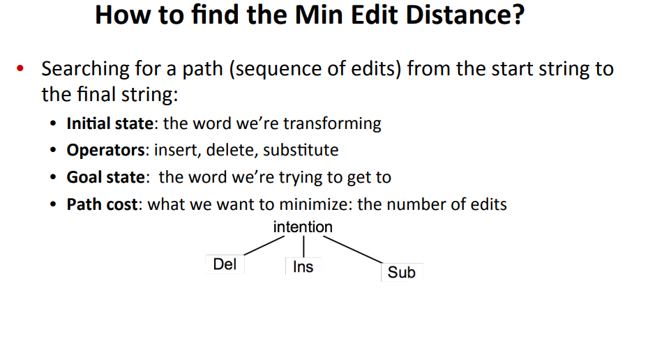

Slide 10
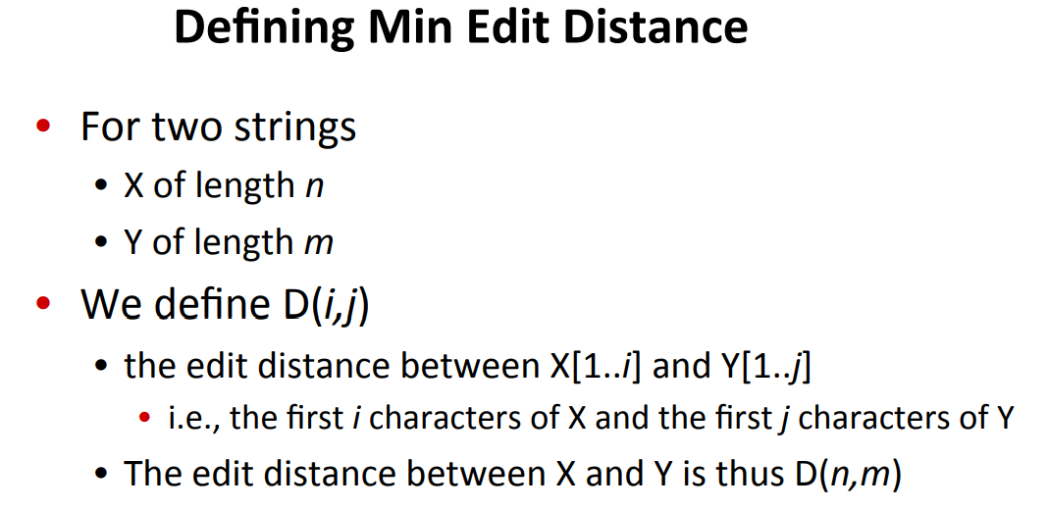

Slide 11
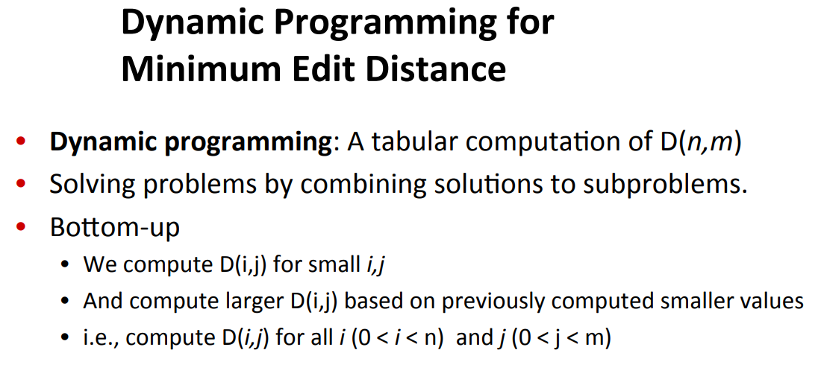

Slide 12
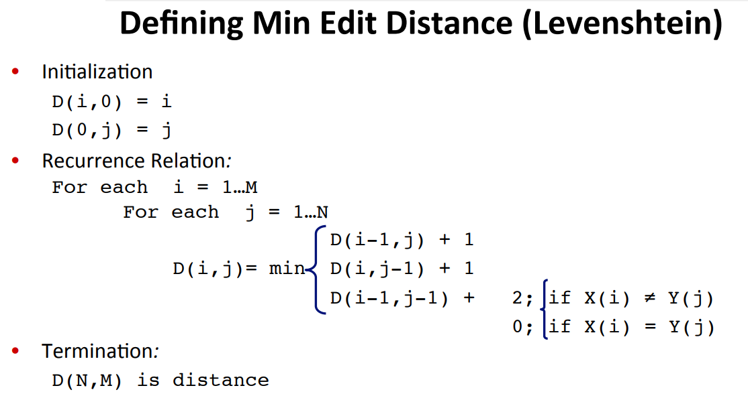

Slide 13
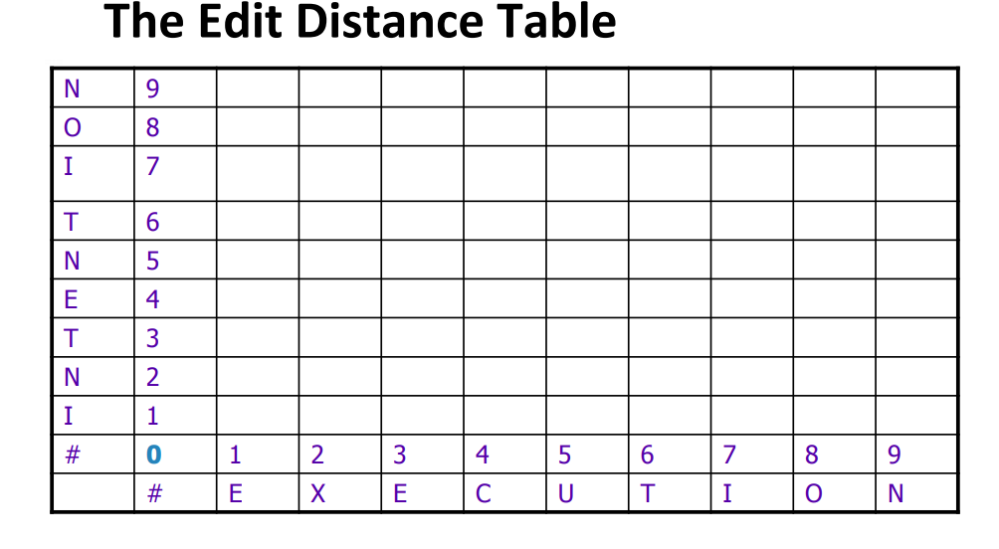

Slide 14
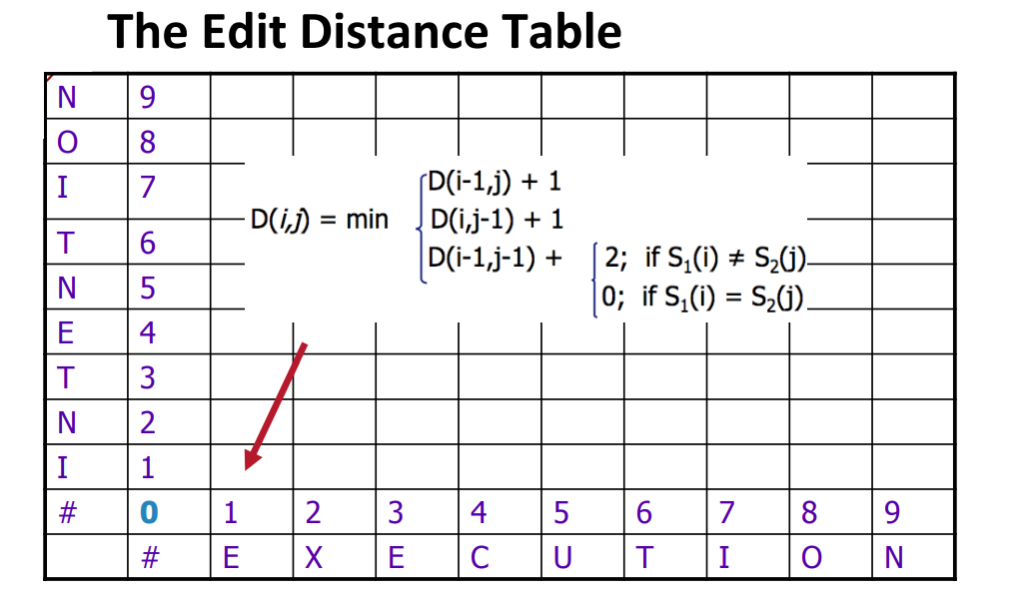

Slide 15
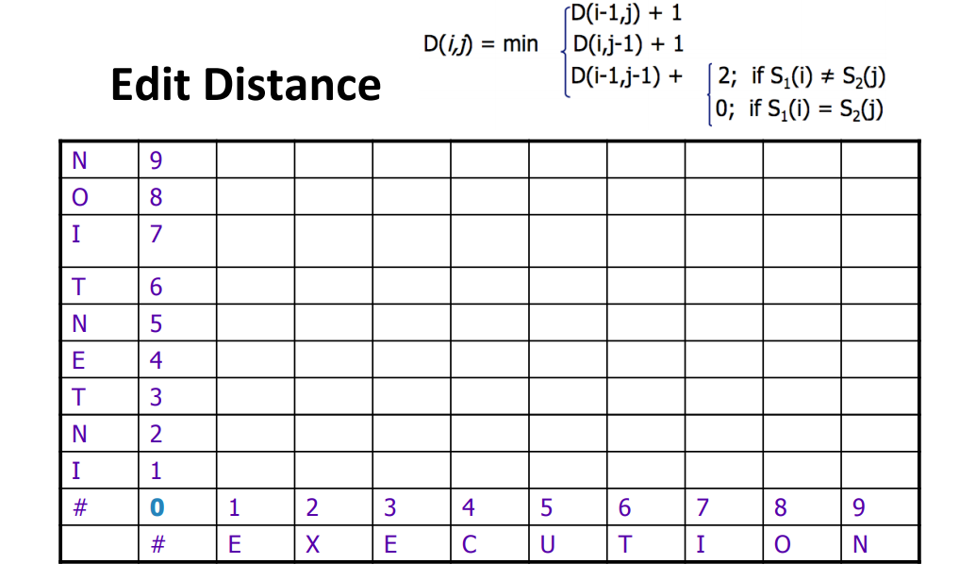

Slide 16
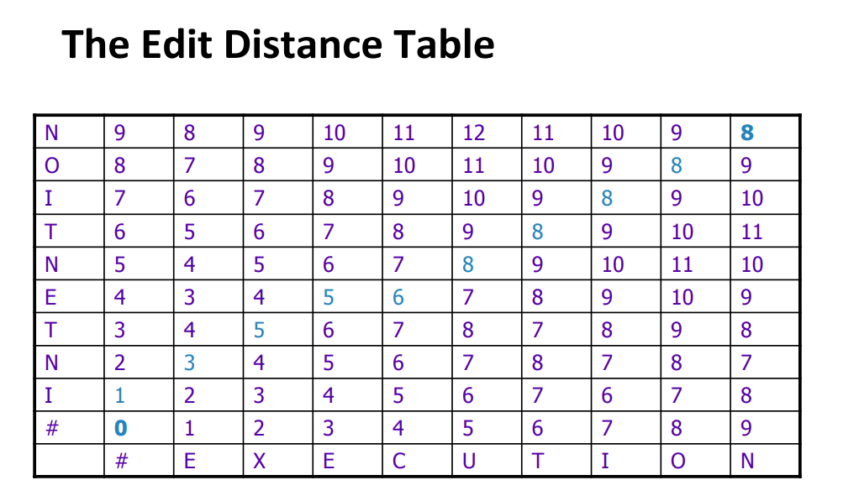

Slide 17
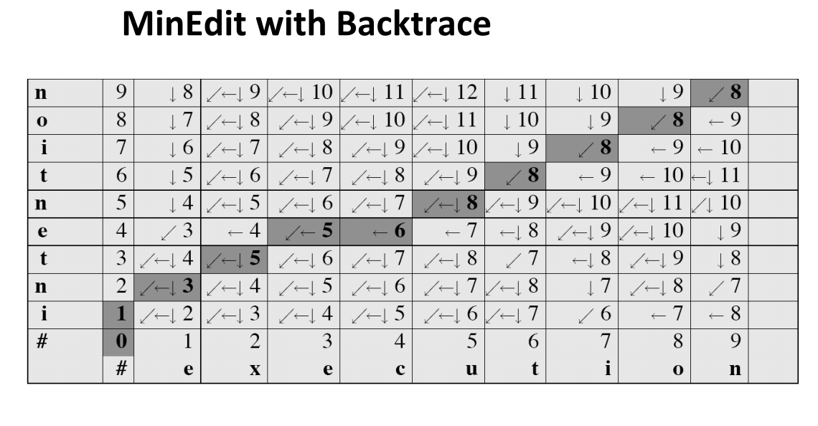

Slide 18
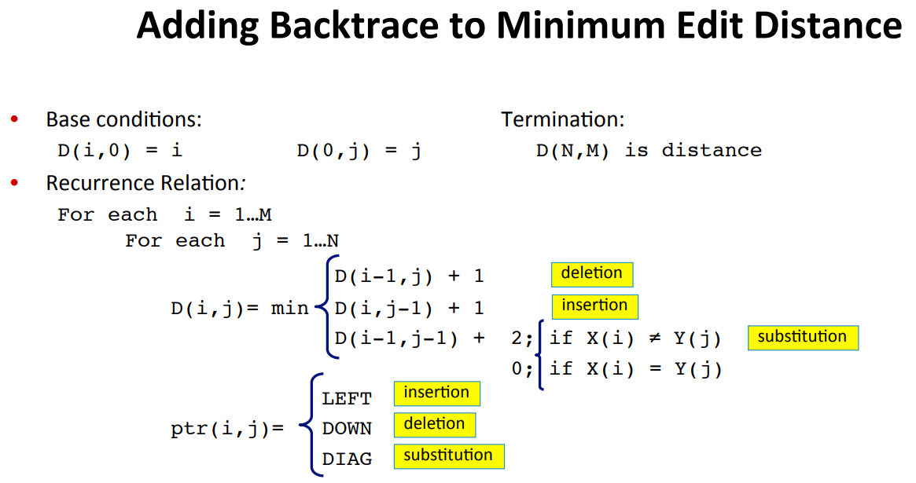

Slide 19
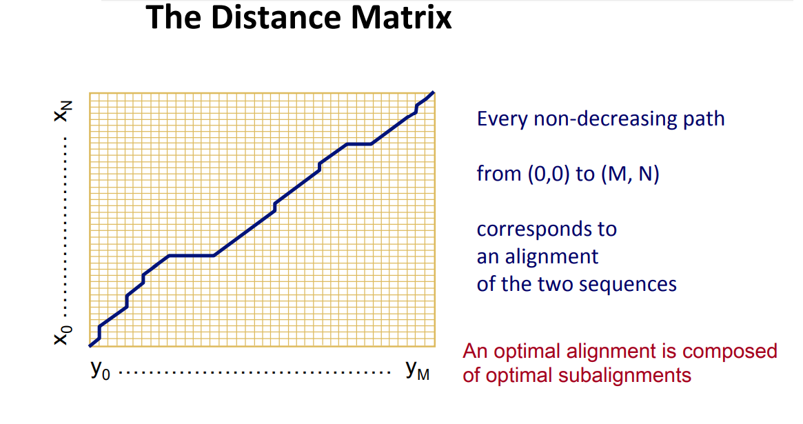

Slide 20
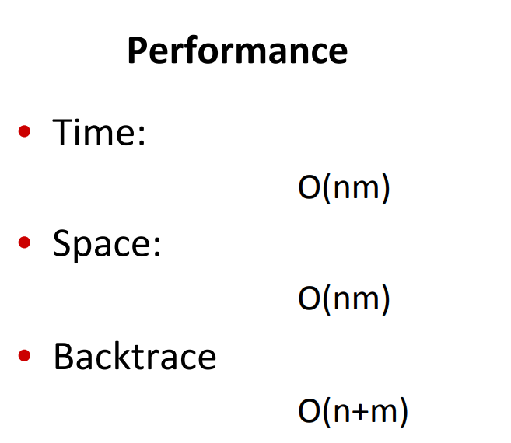

Slide 21
Optimal Binary Search Trees
Binary Search Tree (BST) is a tree where the key values are stored in the internal nodes. The external nodes are null nodes. The keys are ordered lexicographically, i.e. for each internal node all the keys in the left sub-tree are less than the keys in the node, and all the keys in the right sub-tree are greater.
When we know the frequency of searching each one of the keys, it is quite easy to compute the expected cost of accessing each node in the tree. An optimal binary search tree is a BST, which has minimal expected cost of locating each node

Slide 22
Optimal Binary Search tree
Input: A set S of n integers; An array W where W [i] (1 ≤ i ≤ n) stores a positive integer weight.
Output: A BST T on S with the smallest average cost

Slide 23
Number of BST
No. of BST = ^{2n}C_{n}/(n+1) , n is number of nodes in tree

Slide 24
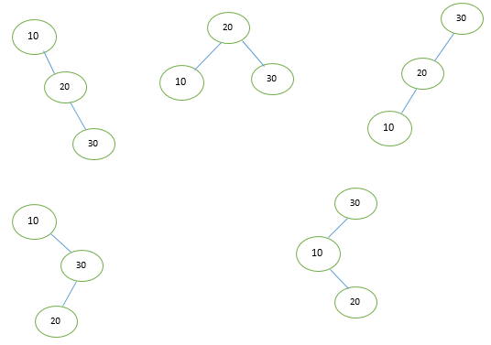
Optimal bst
Given 10, 20, 30
Possible BST are
For n= 3
No. of BST = ^{2*3}C₃/(3+1)
=5

Slide 25
Optimal bst
Case 1: Average Cost = (1+2+3 )/3
Case 2: Average Cost = (1+2+2)/3
Case 3: Average Cost = (1+2+3 )/3
Case 4: Average Cost = (1+2+3 )/3
Case 5: Average Cost = (1+2+3 )/3

Slide 26
Optimal bst - example
X | 10 | 20 | 30 | 40
Freq. | 4 | 2 | 6 | 3

Slide 27
W[0,i] = Sum (q_{i})
C[i,j] = W[i,j] + min { C[i,k-1] + C[k,j]} where k is root and i<k<=j

Slide 28
Tracing
j i | 0 | 1 | 2 | 3 | 4
0
1
2
3
4

Slide 29
Tracing
L=0 | L=1 | L=2 | L=3 | L=4
j-i=0 | 1 | 2 | 3 | 4
[0,0] | [0,1] | [0,2] | [0,3] | [0,4]
[1,1] | [1,2] | [1,3] | [1,4]
[2,2] | [2,3] | [2,4]
[3,3] | [3,4]
[4,4]

Slide 30
Tracing
j i | 0 | 1 | 2 | 3 | 4
0 | 0 | 4⁽¹⁾ | 8⁽¹⁾ | 20⁽³⁾ | 26⁽³⁾
1 |  | 0 | 2⁽²⁾ | 10⁽³⁾ | 16⁽³⁾
2 |  |  | 0 | 6⁽³⁾ | 12⁽³⁾
3 |  |  |  | 0 | 3⁽⁴⁾
4 |  |  |  |  | 0

Slide 31
C[0,4]=w[0,4] +min{16,16,11,20}=15+11=26
C[0,0]+C[1,4]=0+16=16 for k=1
C[0,1]+C[2,4]=4+12=16 for k=2
C[0,2]+C[3,4]=8+3=11 for k=3
C[0,3]+C[4,4]=20+0=20 for k=4

Slide 32
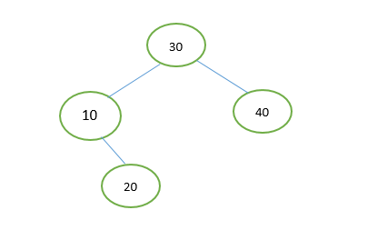
The optimal bst
Total cost = 6*1+2*4+3*2+2*3 = 26

Slide 33
Optimal-Binary-Search-Tree(p, q, n)
c[1…n + 1, 0…n]
w[1…n + 1, 0…n]
root[1…n + 1, 0…n]
for i = 1 to n + 1 do
c[i, i - 1] = q_{i} - 1
w[i, i - 1] = q_{i} - 1
for l = 1 to n do
for i = 1 to n – l + 1 do
j = i + l – 1 e[i, j] = ∞
w[i, i] = w[i, i -1] + p_{j} + q_{j}
for r = i to j do
t = e[i, r - 1] + e[r + 1, j] + w[i, j]
if t < e[i, j]
e[i, j] = t
root[i, j] = r
return c and root

Slide 34
Optimal bst algorithm
Here, the Optimal Binary Search Tree Algorithm is presented. First, we build a BST from a set of provided n number of distinct keys < k₁, k₂, k₃, ... k_{n} >. Here we assume, the probability of accessing a key K_{i} is p_{i}. Some dummy keys (d₀, d₁, d₂, ... d_{n}) are added as some searches may be performed for the values which are not present in the Key set K. We assume, for each dummy key d_{i} probability of access is q_{i}.

Slide 35
Optimal bst algorithm
Analysis
The algorithm requires O (n³) time, since there are 3 level of nested for loops. Each of these loops takes on at most n values.

